Slide 1
Intercultural classes, parents and neighbourhoods
Chapter 10

Slide 2
Overview presentation
cultural differences in education
risks of image-building
intercultural communication
relationship student, teacher and parents
opportunities in education

Slide 3
Different cultures in education
culture: notions, representations, symbols, knowledge, values, norms, habits and traditions
migration streams
integration

Slide 4
Socio-economic problems
parents’ level of education
division in society
effects on schools

Slide 5
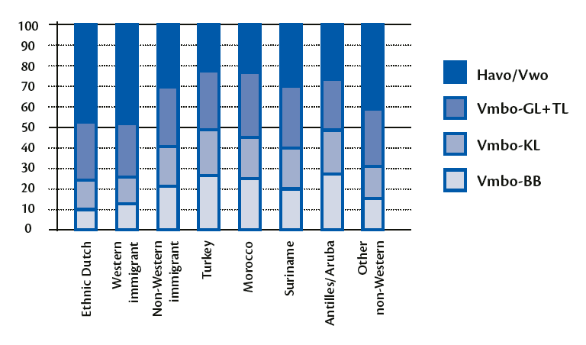
Origin and school type

Slide 6
Risks of image-building
labels, categories, stereotypes and prejudices
pygmalion effect

Slide 7
Intercultural communication
Mental programming
power distance
individualism versus collectivism
masculine versus feminine
uncertainty avoidance
long-term versus short-term orientation

Slide 8
Communication models
Pinto (1994): three-step plan
becoming aware of your own values
figuring out the norms and values of the other person
dealing with differences
TOPOI
Tongue
Order
People
Organisation
Intentions

Slide 9
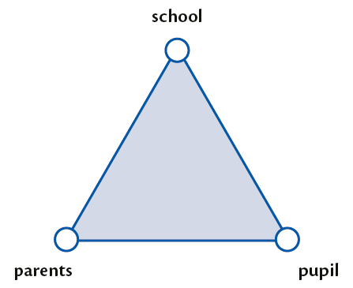
Student, parents and teacher
pedagogical triangle

Slide 10
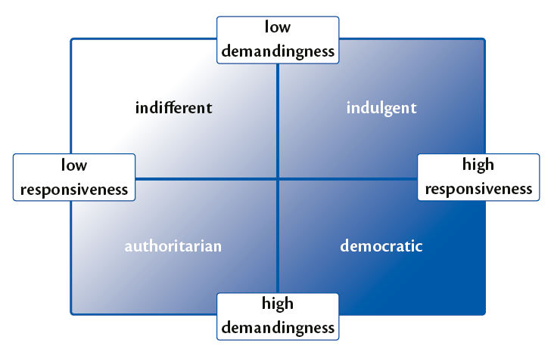
Student, parents and teacher
parenting styles
responsiveness
demandingness
indulgent
indifferent
authoritarian
democratic

Slide 11
Parental involvement
involved and instructive parents
involved and listening
uninvolved but instructive parents
uninvolved but listening parents
uninvolved and not listening parents

Slide 12
The neighbourhood
street culture
civic education

Slide 13
Opportunities in education
language development
designing education
leadership in an intercultural classroom
interest in your students
recognising patterns
the neighbourhood school as an intermediary
‘Vreedzame School’

