Slide 1
Senior secondary vocational education and training (MBO)
Chapter 13

Slide 2
Overview presentation
the target group
guidance in lessons
Work placement
coherence in MBO

Slide 3
Target group
Some of the groups you will come across in MBO are:
BBL (work-based pathway)
BOL (school-based)
levels 1, 2, 3 and 4
older students participating in adult education who take an MBO course
to retrain
older students attending continuing education while still at work

Slide 4
Guidance in lessons
tailored guidance
level of independence
responsiveness of the coach
quality of classrooms
quality of assignments

Slide 5
Work placement
BOL (school-based vocational training)
students join internship workplaces as apprentice staff
spending 20 to 60 % of their course time at different work placements
the remaining time is spent at school taking theory lessons
BBL (work-based vocational training)
students are employed by a company and spend 60 % or more of their course time at work
attend school one day a week for theory lessons

Slide 6
Coherence in MBO
theoretical and practical preparation
try-out placement
methodical: WIOA
wish
imagining
obstacles
action

Slide 7
Structure within work placements
Coherence
in work placements
between practical and theoretical lessons
with general educational subjects
with career guidance
with tests
What does this mean for you?

Slide 8
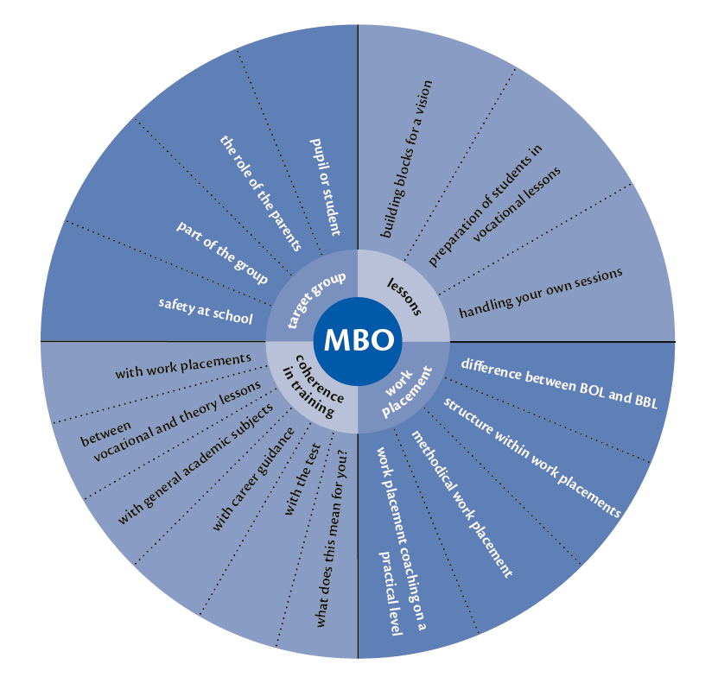
Building blocks for coherence in MBO

