Slide 1
How do students learn?
Chapter 1

Slide 2
Overview presentation
A strong learning environment
competence, relation and autonomy
What is learning?
learning activities and aptitude levels
How the memory works
sensory, short-term and long-term memory
mnemonic techniques
What do learning theories have to say?
behaviourism, cognitivism, behaviourism and constructivism

Slide 3
A strong learning environment
how to recognize
the student’s well-being
the student’s engagement
basic needs
competence
relationship
autonomy

Slide 4
A strong learning environment
competence
I can do it!
I am someone who can get things done
I feel confident about my own ability
I feel accepted and valued
relationship
I belong
I feel secure
I feel that I’m valued
autonomy
I have an impact!
I can work autonomously
I am independent
I am a unique person
Children’s development occurs in interaction with their environment
Quality of their environment is a strong determinant of the end result.

Slide 5
Competence
making the learning process transparant
analyse the thinking process
have the students things explain to each other
motivating students
the teacher’s enthusiasm
making content meaningful
the teacher’s expectations

Slide 6
Sources of learning…
What we read 10%
What we hear 20%
What we see 30%
What we see and hear 50%
What we discuss 70%
What we experience 80%
What we explain to others 95%

Slide 7
Relationship
stimulating and utilising the social process
social constructivism
involve all students
activating didactics
communication advice
basic rules of communication

Slide 8
Autonomy
different learning styles
multiple intelligences

Slide 9
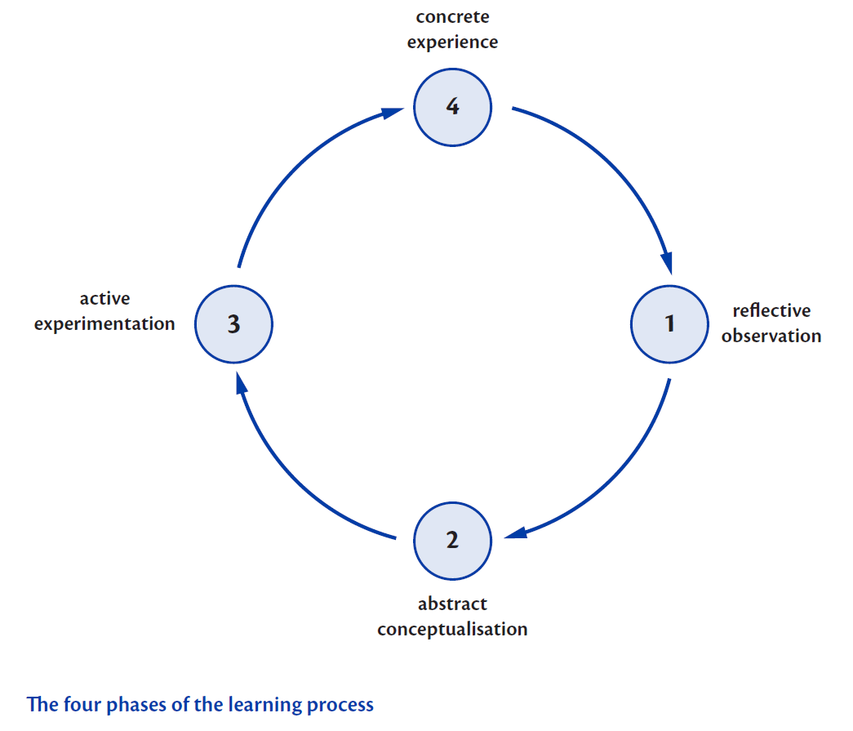
Kolb: four phases of the learning process

Slide 10
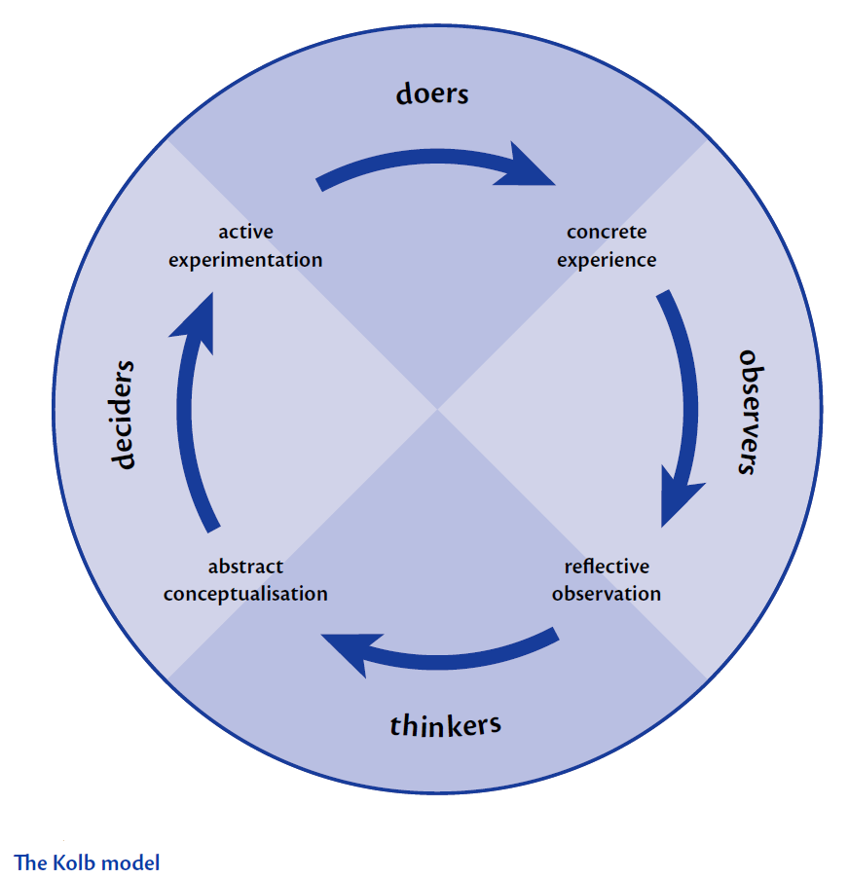
The Kolb model

Slide 11
Gardner’s multiple intelligences
Intelligence:
the ability to learn problem solving
the theory offers:
insight into the stronger abilities of each student
extra perspectives into the student’s learning process, enabling fine-tuning of the lessons
the option to utilise specific qualities of a student and to optimise lesser qualities

Slide 12
Gardner’s multiple intelligences
verbal / linguistic
logical / mathematical
visual / spatial
bodily / kinesthetic
musical / rhythmic
naturalistic
interpersonal
intrapersonal

Slide 13
What is learning?
Learning: a mental process in which learning activities result in a relatively stable change in behaviour.
intentional learning
learning activities
results

Slide 14
Students and the learning process
Learning through:
direct experience
going through or acting out (by trial and error)
social interaction
the process of exchanging information with others
thinking/reflection
by actively considering the topic; prior to, during, or after acting
by processing theory
through assignments

Slide 15
Four stages of information processing
remembering
understanding
integrating
applying

Slide 16
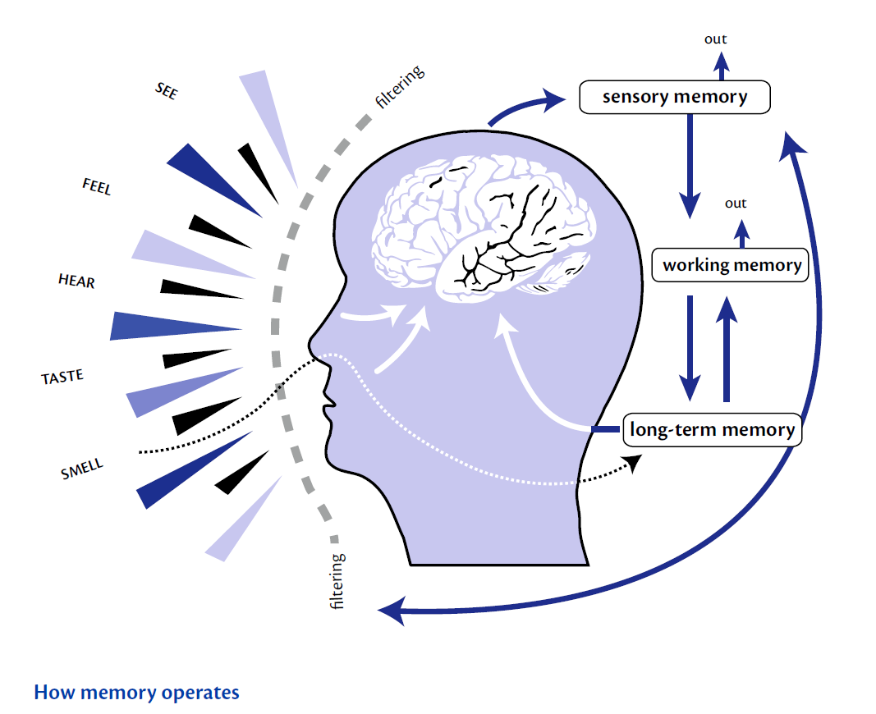
How the memory works

Slide 17
Three types of memory
sensory memory the gate-keeper
short-term memory working memory
long-term memory
knowledge storage

Slide 18
Sensory memory
Task retaining new information roughly
Goal compare with existing knowledge
Only recognisable information is admitted to the short-term memory.
Selective attention takes place at a subconscious level.

Slide 19
Short-term memory
Ways to retain information for a longer time
repetition
maintenance repetition
elaborated repetition
encoding: mnemonic techniques

Slide 20
Mnemonic techniques
applying a mnemonic
physical reminders
Roy G. Biv
method of loci
mind mapping

Slide 21
Long-term memory
Principles:
egocentric tendency
key concept
personal interpretation
reproduction of the latest version

Slide 22
Short- versus long-term memory

Slide 23
What do learning theories have to say?
behaviorism and conditioning
cognitivism and metacognition
cognitive behavioural theory and mental processes
constructivism and key features of education

Slide 24
Behaviorism
Two closely connected learning theory principles:
classical conditioning (Pavlov)
operant conditioning (Skinner)

Slide 25
Classical conditioning
emotional learning
stimulus generalization
laws of classic conditioning (Thorndike)
law of repetition
law of effect
insight
rewarding desirable behaviour is more effective that punishing unwanted behaviour

Slide 26
Operant conditioning
The basis is spontaneous behavior
fine-tuning behavor:
positive reinforcement
negative reinforcement (avoidance learning)
Programmed instruction
self-teaching programs that a learner goes through step-by-step (e.g. a video game)

Slide 27
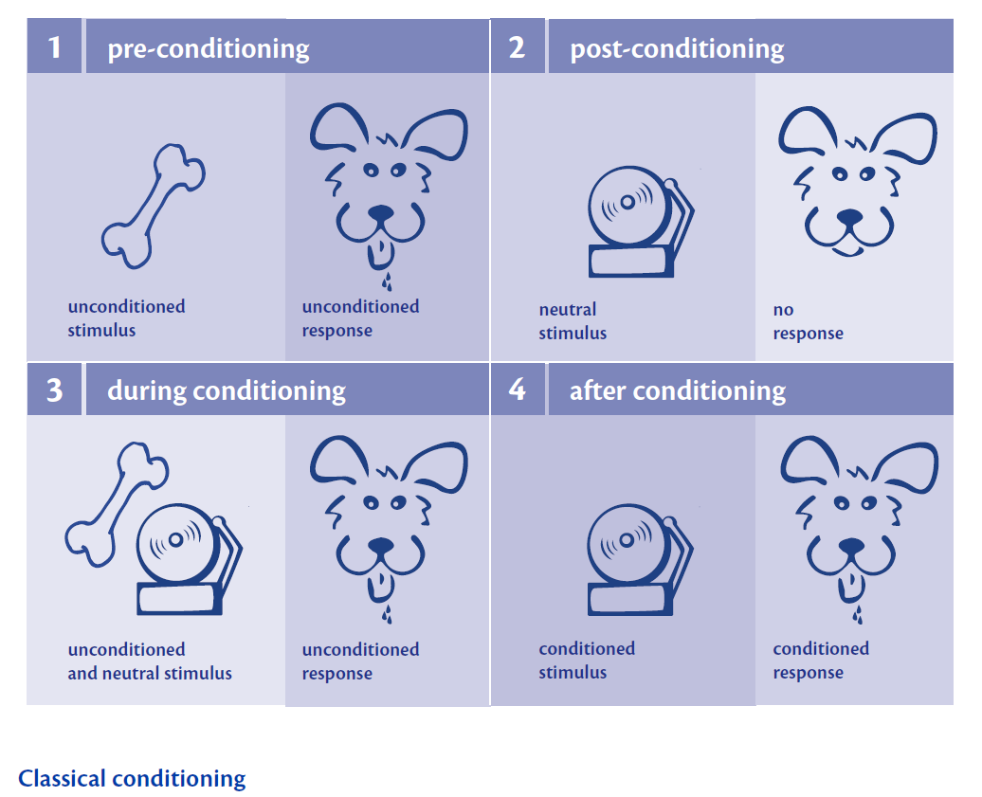
Classical conditioning

Slide 28
Contemporary behaviouristic elements
spontaneous behavior as a starting point
shaping behaviour:
positive reinforcement
negative reinforcement (avoidance learning)
programmed learning
comprehensive and detailed learning programmes students had to follow in stages

Slide 29
Contemporary behaviouristic elements
Experiencing success has a positive effect.
Positive reinforcement of student behaviour is more effective than negative reinforcement.
Complex behaviour or complex knowledge is best acquired by learning sub-activities.
Formulate attainment targets by describing observable behaviour.

Slide 30
Cognitivism and metacognition
cognitivism
the student as an active information processing system
if-then statement
declarative knowledge
procedural knowledge
‘knowledge about your own knowledge’ or metacognition
four types of knowledge
declarative knowledge
procedural knowledge
situational knowledge
strategic knowledge
(renewed interest because of the recent focus on ‘learn how to learn’)

Slide 31
Cognitivism and mental processes
It is through this interaction that students develops knowledge, ideas, values and ethics.
mental action: dialogic principles

Slide 32
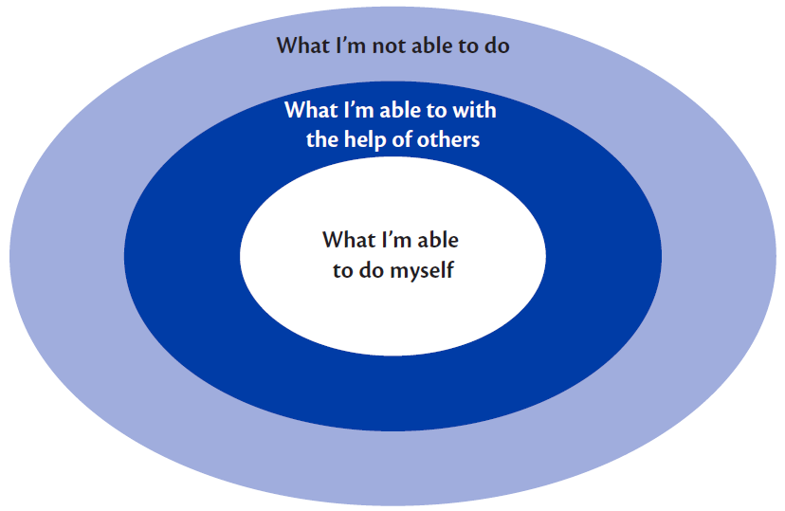
Mental processing (Vygotsky)
four principles:
interiorization
zone of proximal development
the central adult
the social-communicative background of
mental actions
basics:
the learning content should continue where the student’s knowledge ends
the teacher is expert

Slide 33
Constructivism’s core concepts
a student has an innate drive to find things out for himself
understanding is a matter of structuring and/or reorganising information
mental images are replaced by new experiences
understanding is never finite
the ability to learn depends on a student’s development as well as his maturity, which can vary with age
reflection, self-correction and feedback stimulate the learning process

Slide 34
Constructivist learning theory
Key concepts in education:
the learner takes an active role
prior knowledge is the starting point for new information
a learning process is an individual process
learning is a social experience

