Slide 1
How do I keep order?
Chapter 4

Slide 2
Overview presentation
communication in order
Leary’s Rose
classroom management
Kounin
handling conflicts
Thomas & Kilmann

Slide 3
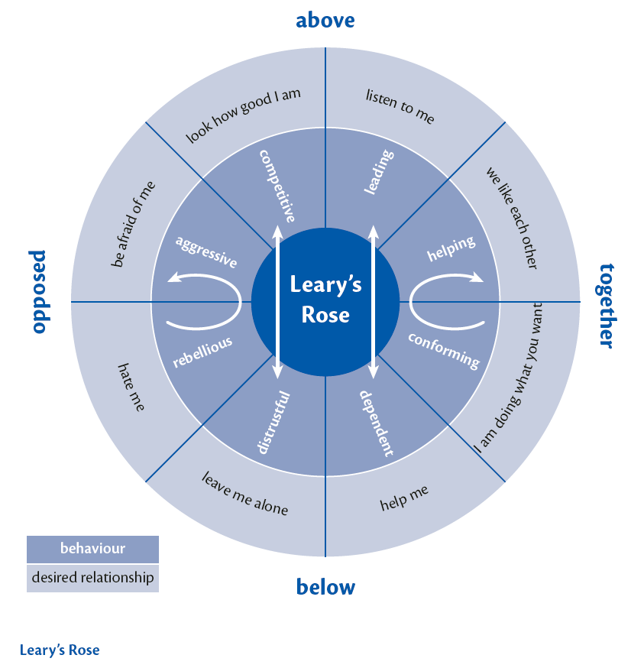
Communication in order

Slide 4
Interaction on the axes on Leary’s Rose

Slide 5
Leary’s Rose in practice
eye contact
distance
facial expression
body language and gestures
use of voice

Slide 6
Classroom management
The five skills of Kounin
continuous signal
Alertness and the ripple effect
overlapping
keeping students’ attention
student responsibility

Slide 7
Continuous signal
a smooth and stable lesson
good preparation
implementation
make contact
keep control
transitional moments
student-controlled

Slide 8
Alertness and the ripple effect
Students think the teacher is alert when he:
calls the right student to order
reacts early
alertness:
to names
to expressing leadership
in word and gesture

Slide 9
Overlapping
do two things at the same time
escalation stairway
professional and personal limits
student-controlled

Slide 10
Keeping the students’ attention
Magic
clothing
subject matter
focus
during student-controlled situations

Slide 11
Student responsibility
delegating
reacting responsively
being strategically consistent
in student-driven situation

Slide 12
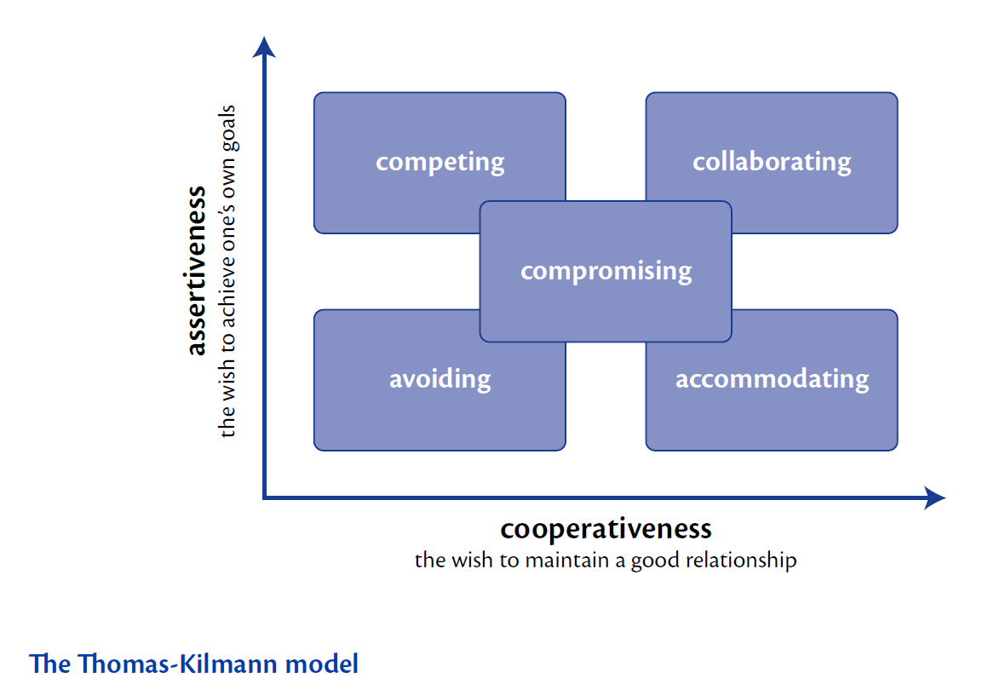
Handling conflicts

Slide 13
Intrapersonal conflict
How to solve my dilemma:
identifying the problem
thinking of a solution
judging the ideas
Acceptance
execution

