Slide 1
Testing and assessment
Chapter 5

Slide 2
Overview presentation
function of tests
working towards goals
converting learning objectives to tests
Bloom’s taxonomy
Miller’s pyramid
assessment and grading

Slide 3
The function of tests
selection, geared towards admission
qualification, geared towards determining levels
educational tool, geared towards adjusting teaching

Slide 4
Formative tests
tells us about the study progress and skill level of a student
to make adjustments
practice function
diagnostic function

Slide 5
Examples of formative tests
unannounced quiz
assessing homework
practice test
presenting products
exam practice
progress test
discussing concepts
presenting interim results

Slide 6
Summative tests
selection and qualification
explicitness
many small summative tests
little practice time
every assignment becomes important
the teacher has to grade a lot of tests and give feedback on them
students do not experience deadlines and might stop studying for tests

Slide 7
Examples of summative tests
national exams
driving test
swimming test
school exam
college exam
transition tests

Slide 8
Testing as a classroom activity
Peer assessment - benefits
students address each other in their own language;
students act like a group and learn how to work together methodically;
students are inspired by each other’s achievements;
students learn to assess by articulating what they have noticed;
students feel responsible for their own learning;
students realise that their learning is part of a greater, more complex operation.

Slide 9
Working towards goals
goals and targets
core targets and reference levels
final exams at secondary school
MBO qualification file

Slide 10
Roles of the education inspection
secondary education | mbo
progressing through the first years | instruments for testing and qualification files
results in the final years | accurate assessments
difference between internal exam grades and central exam grades
students’ scores

Slide 11
Converting learning objectives to tests
How to make learning objectives concrete and measurable:
demonstrable performance
behaviour
content
conditions
Higher-order and lower-order learning objectives

Slide 12
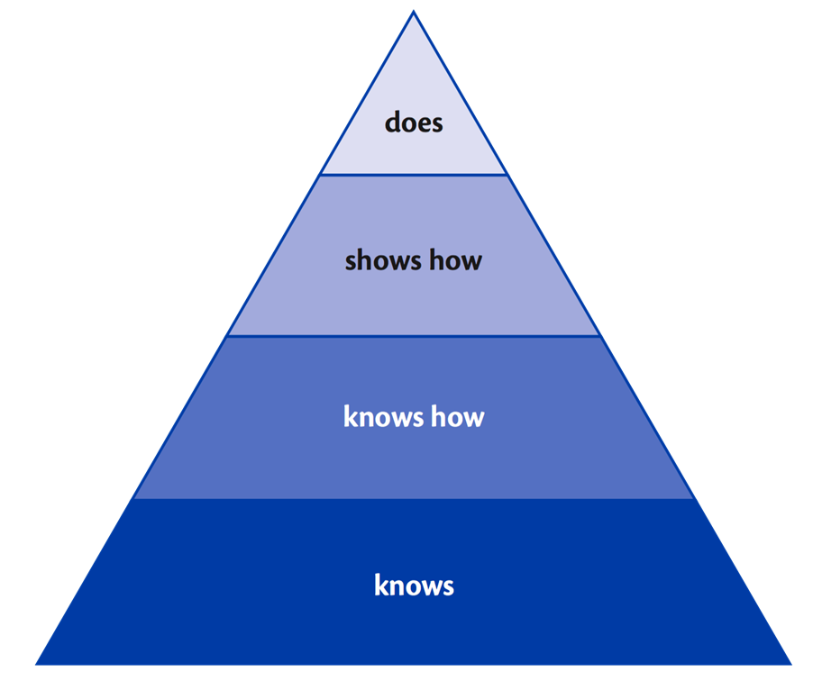
Miller’s pyramid of competences

Slide 13
‘Knows’ level
Test items at this level assess whether students can distinguish different conceptual frameworks and label different phenomena.
assessment – right interpretation
tips:
answer before question
set boundaries for the answer
short questions
make open written questions

Slide 14
‘Knows how’ level
practical assignments that require a design for solving or analyzing a problem, in their own words
assessment: provide boundaries and limit them
tips:
Use an authentic problem as a starting point.
Ask questions about the case that cover the entire case.
Ask knowledge questions independently of insight questions.
At least one question should cover the entire subject.
Good case study focuses on understanding and insight, and should contain mostly higher-order thinking questions.

Slide 15
‘Shows how’ level
questions designed to reveal the learner’s approach and their competences by using simulations or fictive assignments
teachers should agree on what the essence of the task is, and on how to assess it holistically
tips:
the criteria for assessment need to be known in advance
rubric

Slide 16
Does level
A student performs a task in a real-life situation under typical circumstances.
recommendations:
transparent assignment
Dochy’s triangulation
products
description of processes
demonstrated behaviour

Slide 17
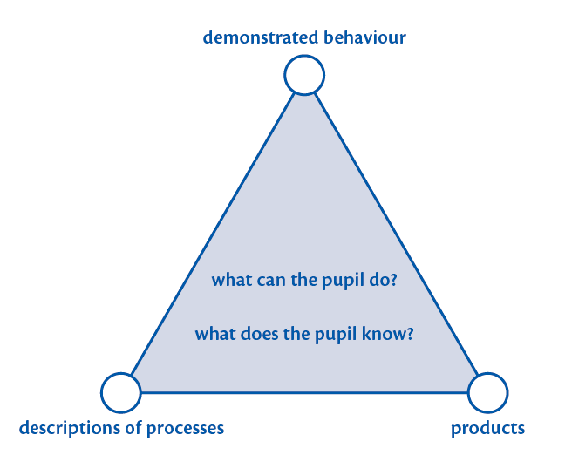
Dochy’s triangulation

Slide 18
The value of a grade
pass / fail grades
predictive value
full range of grades is not used
forming the grade
averaging grades is unfair
resits of a test are assessed more strictly
no clear policy regarding which grades count towards the final grade

Slide 19
A good test…
transparency
A test is transparent when students know what is expected of them.
validity
A test is valid when it assesses what it aims to test.
reliability
A test is reliable when it can be used as a base for a sound decision.
usability
A test is usable when it meets its intended purpose.

Slide 20
Assessment and grading
relative grading | absolute grading
advantage the grading can be easily adjusted according to the difficulty of the test | advantage students receive a grade regardless of the group results
drawback results of the group have no influence on the individual grades of a student | drawback there is no correction for a design flaw in the test

